Slide 1
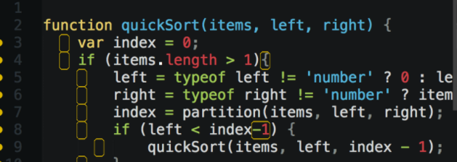
JavaScript Training JS is not perfect but works
Krzysztof Danielewicz
Special thanks to: Maracelina Skopek-Szemik, Anton Horetskyi

Slide 2

About me
.net developer with 7 year experience
Expertise in Front-end technologies: JS, angularJS, CSS
Current assignment Total Cost of Ownership for Volvo Penta
Offline web app using Application Cache, AngularJS
The app estimates maintenance cost of Volvo Penta engines.

Slide 3

Agenda
Understanding JS
scopes, hoisting
Objective JS
prototype, closure, module pattern
ECMAScript5
array functions, strict mode
Future and necessary fixes
ECMAScript2015, TypeScript, Transpilers

Slide 4

Scopes of variable
JavaScript has only two types of scope:
Global scope – global is nothing but a window level scope. Here, variable present throughout the application.
Functional scope – variable declared within a function with var keyword has functional scope. Variable declared there are not visible outside.
Notes:
Variable declared in global scopes are avilable
JS Syntax is similar to C syntax languages (Java, C#). Syntax is the same for statements i.e.: while, for, if and function.
lock statements apart from “function” have different behaviour to the modern languages. They do NOT create local scopes with var statement.

Slide 5
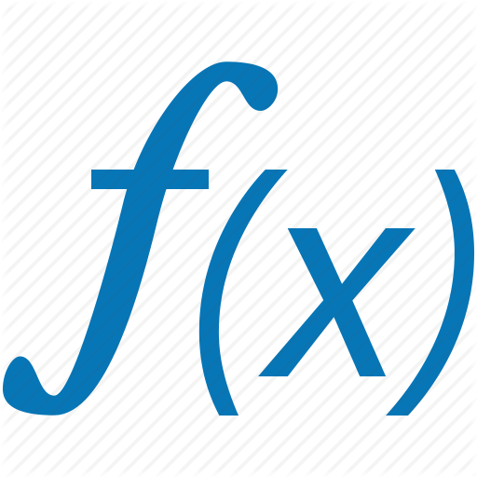
“function” create a scope
var temp = ‘OUTER’;
function f1() {
var temp = ‘INNER’;
}
f1();
console.log(temp); // Console prints: ‘OUTER';
Notes:
In this case the global variable temp overrides inside function

Slide 6

“for”, “if”, “while” don’t create a scope
var temp = ‘OUTER’;
for / if / while f1() {
var temp = ‘INNER’;
}
f1();
console.log(temp); // Console prints: ‘INNER';

Slide 7
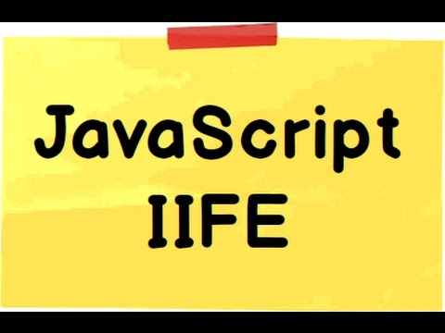
IIFE Immediately Invoked Function Expressions
IIFE is a JavaScript function that runs as soon as it is defined.
(function(){
})();
Notes:
Why would you use if?
To Avoid Polluting the Global Scope.
To fix issues with blocks: if, while, for,

Slide 8

Fix with IIFE
var temp = 'outer';
for / if / while (…) {
(function () {
var temp = 'inner’;
})();
}
console.log(temp); // Console prints: 'outer'
Notes:
There is A LOT of closure, function in JS.

Slide 9

ES2015 – let + const = JS safe scope
ECMAScript 2015 (ES2015/ES6): The 6th edition of ECMAScript, standardized in 2015
ECMA2015 introduces let and const keywords which create scopes for variables and constant in block statements: if, while, for.

Slide 10
Fix with let
var temp = 'outer';
for / if / while (…) {
let temp = 'inner’;
}
console.log(temp); // Console prints: 'outer'

Slide 11

Hoisting
JavaScript mechanism where variables and function declarations are moved to the top of their scope before code execution.
Notes:
Examples: hosting.js, hosting.2.js

Slide 12

Inheritance with prototype 1/2
var Animal = function(name){
this.name = name;
};
Animal.prototype.makeSound = function () {
return ('('+this.name+')');
};
Notes:
One time method, property is defined for all instance of objects.

Slide 13
Inheritance with prototype 2/2
var Cat = function () {
Animal.call(this, "cat");
}; Cat.prototype = Object.create(Animal.prototype);
Cat.prototype.constructor = Cat; Cat.prototype.makeSound = function(){
var base = Animal.prototype.makeSound.call(this);
return ('meow '+base);
}

Slide 14

Closure
A closure is an inner function that has access to the outer (enclosing) function's variables—scope chain.
The closure has three scope chains:
it has access to its own scope (variables defined between its curly brackets),
it has access to the outer function's variables,
and it has access to the global variables.
Notes:
Usage of closure to emulate private member functions, variables.

Slide 15
Closure example
function makeFunc() {
var name = ‘Volvo’;
function displayNameFn() {
console.log(name);
}
return displayNameFn;
}
var myFunc = makeFunc();
myFunc();
Notes:
A closure is an inner function that has access to the outer (enclosing) function's variables—scope chain.
More examples VS Code
it has access to its own scope (variables defined between its curly brackets),
it has access to the outer function's variables,
and it has access to the global variables.

Slide 16

Module pattern
var MODULE = (function () {
var my = {},
privateVariable = 1;
function privateMethod() {
// ...
} return { moduleProperty: 1, moduleMethod: function () {} };
}());

Slide 17

JS standards – ECMAScript
Standard | Year | Browser support | Major featurs added | Enterprise mode (IE8)
ECMAScript 3 | 1999 | Older browsers | Regular Expressions, try/catch | Yes
ECMAScript 5 | 2009 | IE11, evergreen browsers | "strict mode", array functions | No
ECMAScript 2015 | 2015 | 96%-99% evergreen browsers | Classes and modules. | No
ECMAScript 2016 | 2016 | 72%-87% evergreen browsers | exponential operator, Array includes | No

Slide 18

ECMAScript5 – C# Linq vs array functions
C# | ECMAScript5
Where() | filter()
Select() | map()
Any() | some()
All() | every()
Aggregate() | reduce()
ForEach() | forEach()

Slide 19
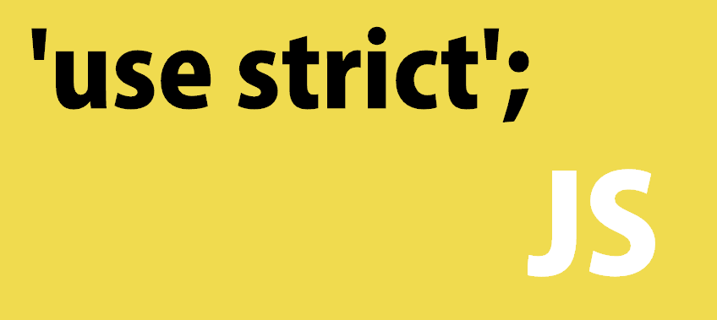
ECMAScript5 – strict mode
Strict mode is a way to introduce better error-checking into your code.
Put in the beginning of the file or the function:
“use strict”;
Recommended only for new code and inside iife. Strange bugs / behavior for legacy code when is turned of.

Slide 20
Strict mode – ECMAScript5
Strict mode is a way to introduce a better error-checking into your code.
Restrictions:
Using a variable without declaring it.
Writing to a read-only property.
The value of this is not converted to the global object when it is null or undefined.
Deleting a variable, a function, or an argument.
Notes:
Pragma strict is a way to tell javascript to "be a stricter compiler". That is, it should throw errors when you try to do dumb things that javascript allows. C# is by nature "stricter" and doesn't need to be told to do that.

Slide 21
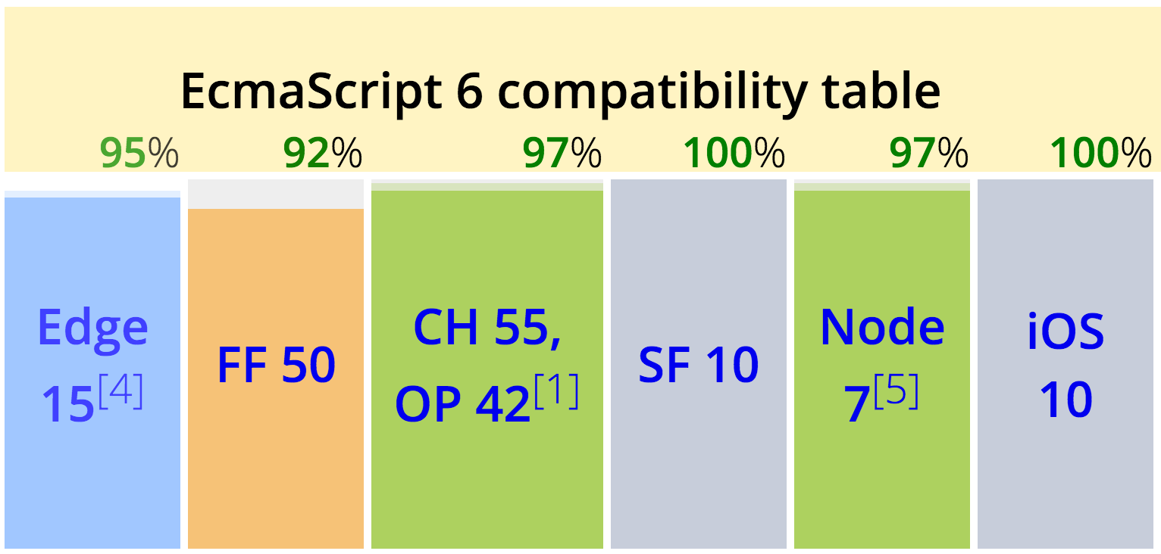
Future – ECMAScript 2015 (ES2015)
Arrow functions
Classes
Template strings
Let + Const
Iterators + For … Of
Modules and much more…
Notes:
Classes doesn’t have private methods

Slide 22


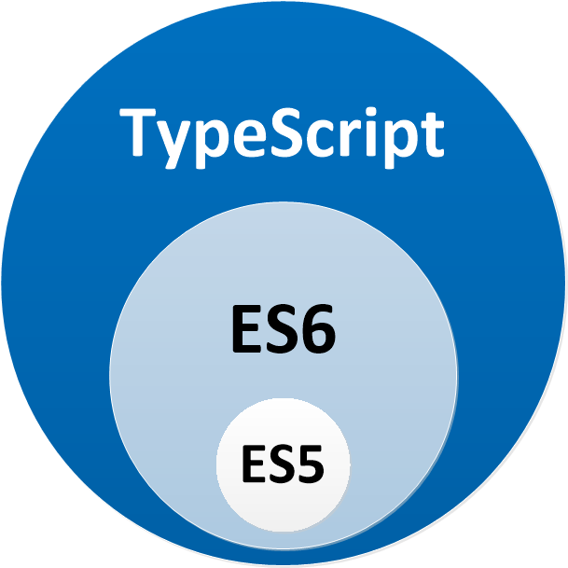
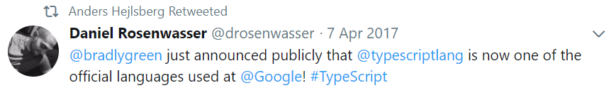
Code with static typing
Annotations
Interfaces, enums
Intellisense
Await / Async
Notes:
7 apr 2017 ,TS is official lang in Google.

Slide 23


Hybrid solutions – Transpilers
TypeScript
Tools: node.js tools, Visual Studio, VS Code
allow-js
Type definitions
ECMAScript 2015 (ES6)
BabelJS
Output code is targeting standards :
ES 3, ES 5, ES 2015

Slide 24

Q&A
Q &A

Slide 25
References
https://app.pluralsight.com/library/courses/javascript-from-fundamentals-to-functional-js/table-of-contents
https://developer.mozilla.org/
https://babeljs.io/learn-es2015/
https://www.typescriptlang.org/
“JavaScript: The Good Parts”, by Douglas Crockford

Slide 26


